Slide 1

Group D
Project Topic: Orphanage Management System
222-115-190 Ahmed.
222-115-094 Abira Haydar Luthfa
222-115-105 Abdullah Mohammed
222-115-116 Jahid Hasan
222-115-169 Md Shorif
222-115-179 Amjad Hosen Jilany

Slide 2


Slide 3
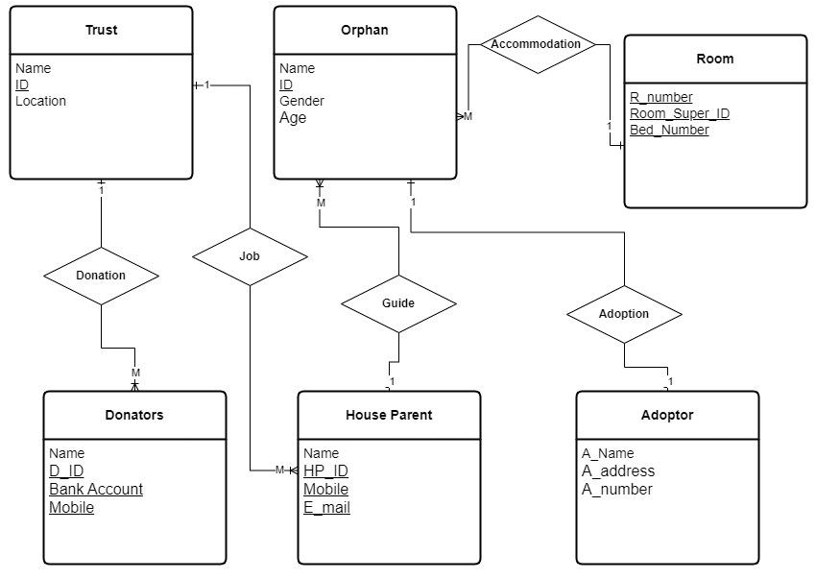
ER Diagram of Orphanage Management System (OMS)

